Slide 1
Smart Traffic Lights
MA1 Project – Hardware/Software
FLAMENT Dorian – NGUYEN Thuy hai

Slide 2
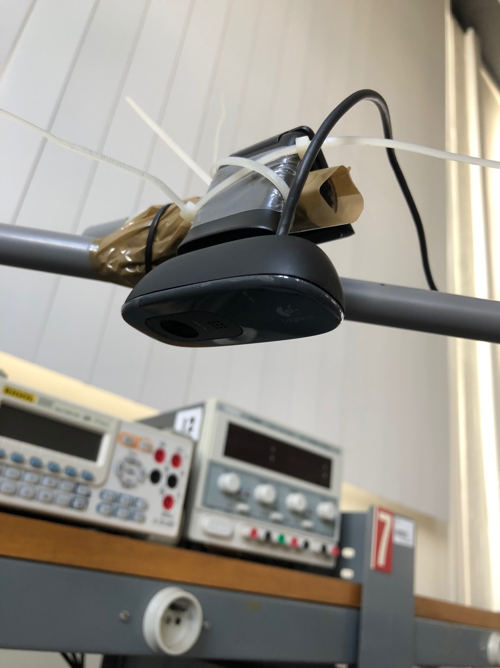
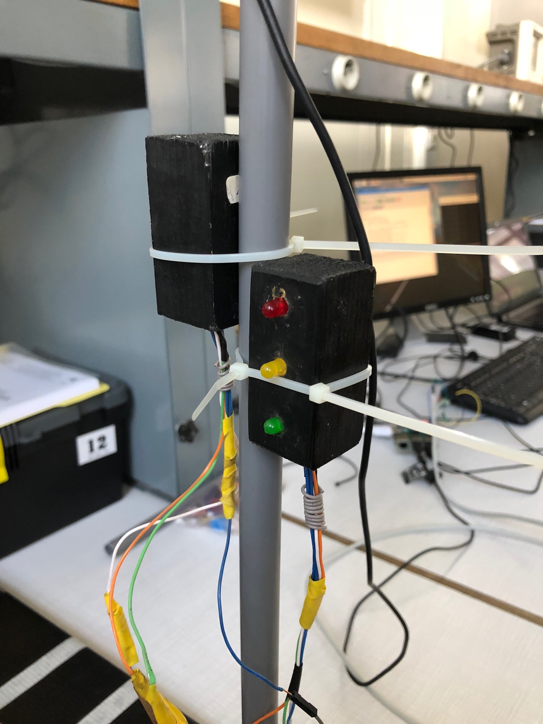
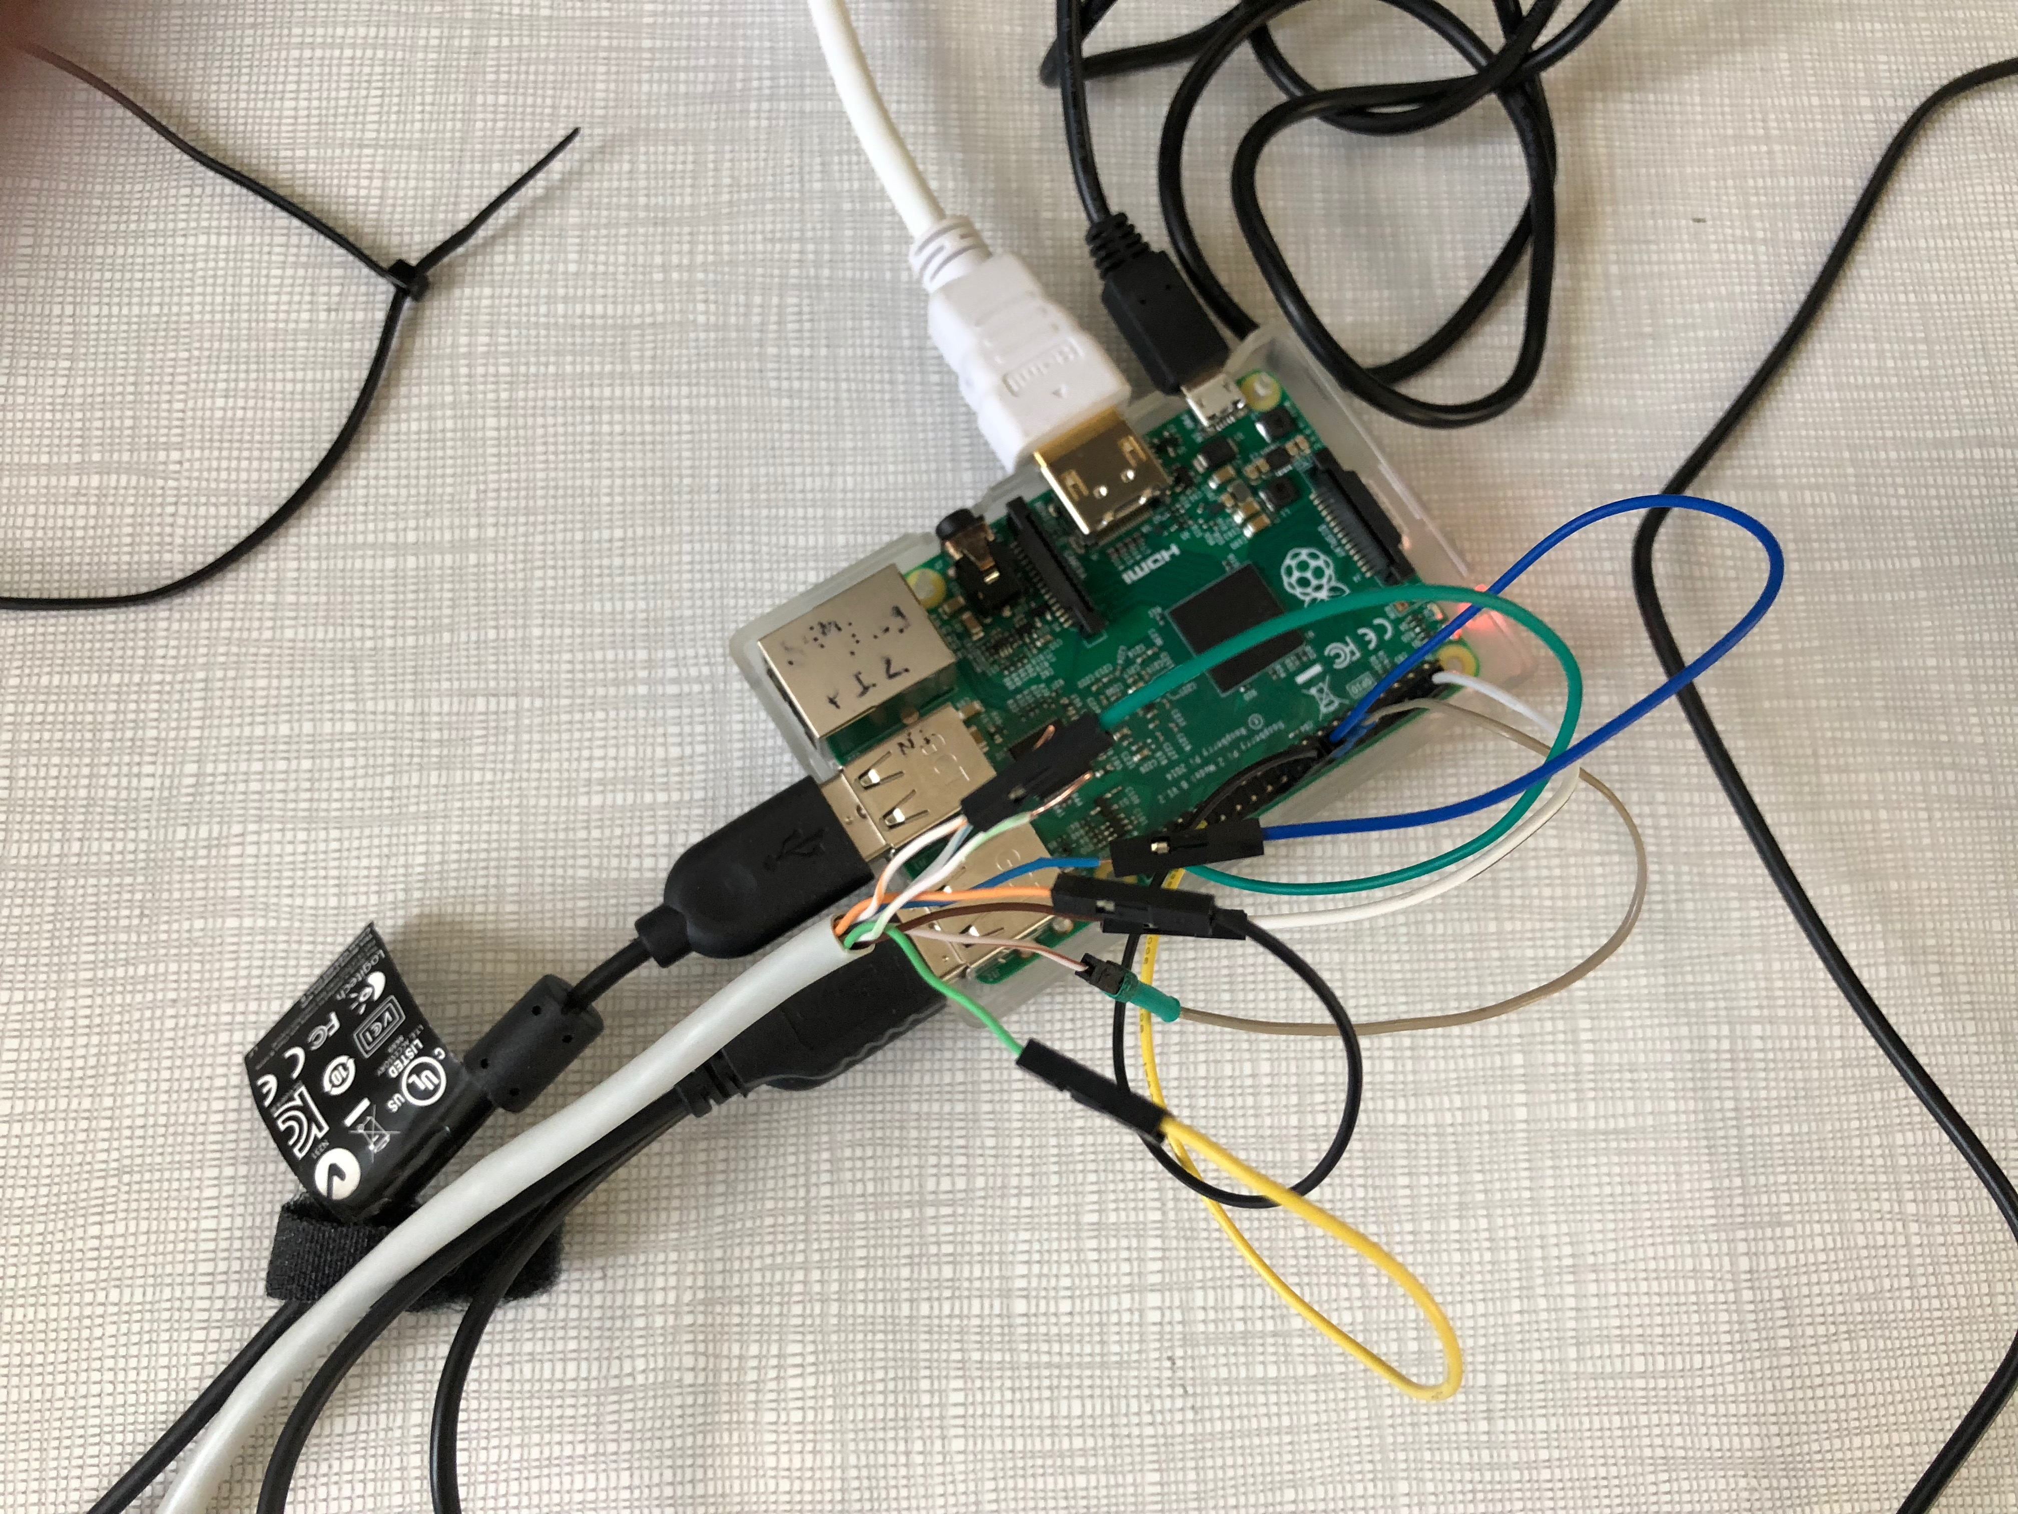
Components of our project
Webcam
Traffic Lights with LEDs
Raspberry PI

Slide 3
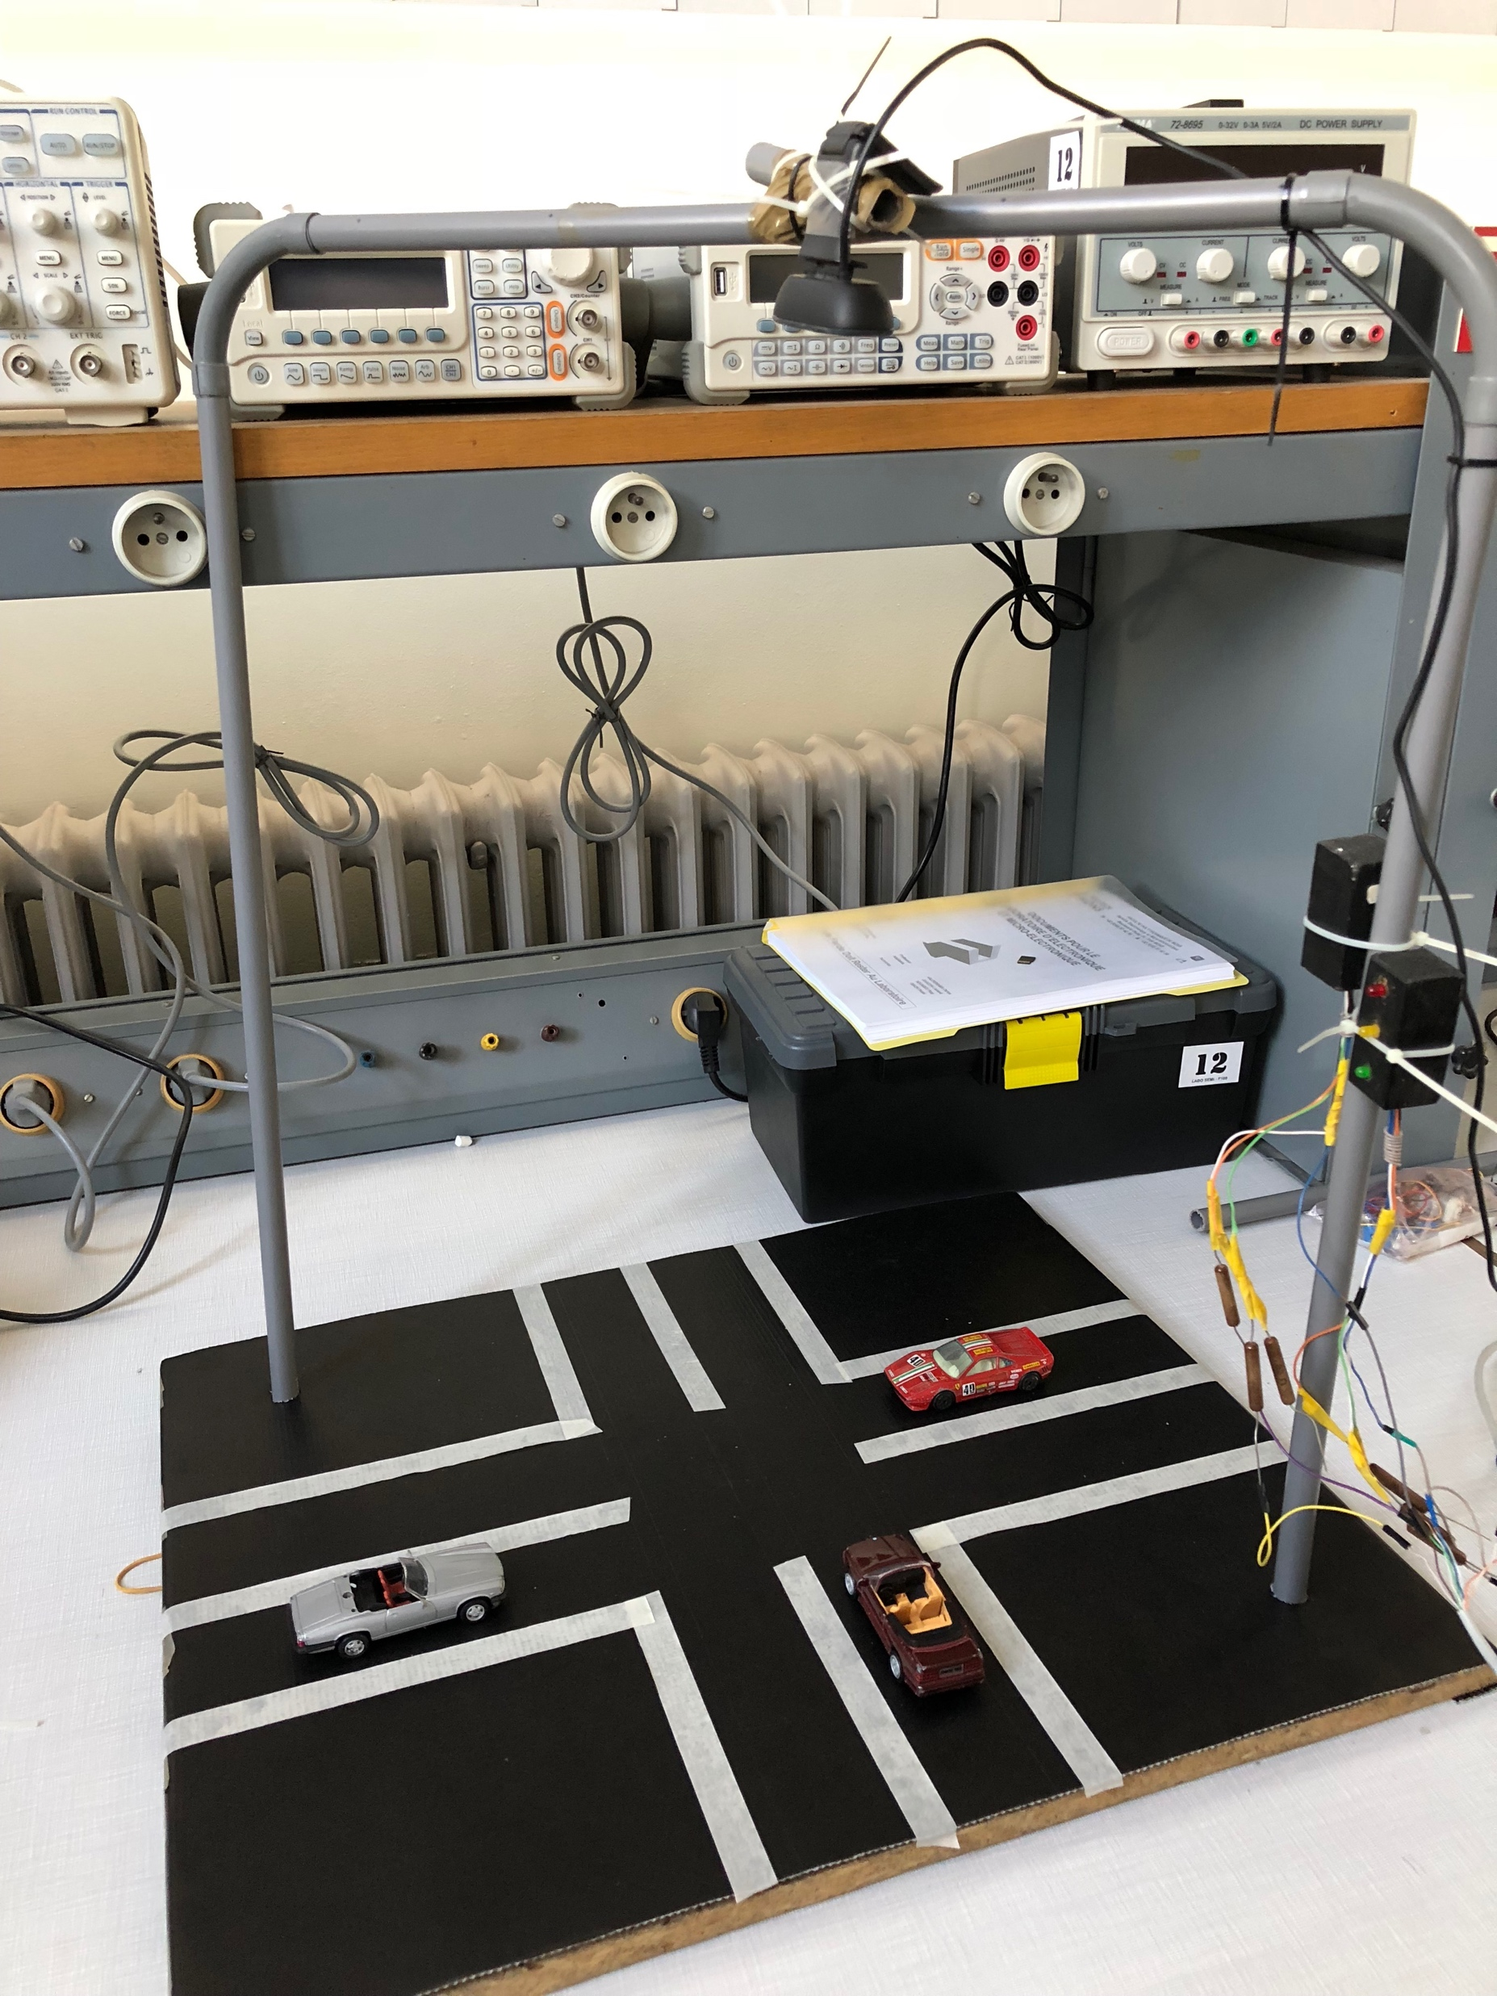
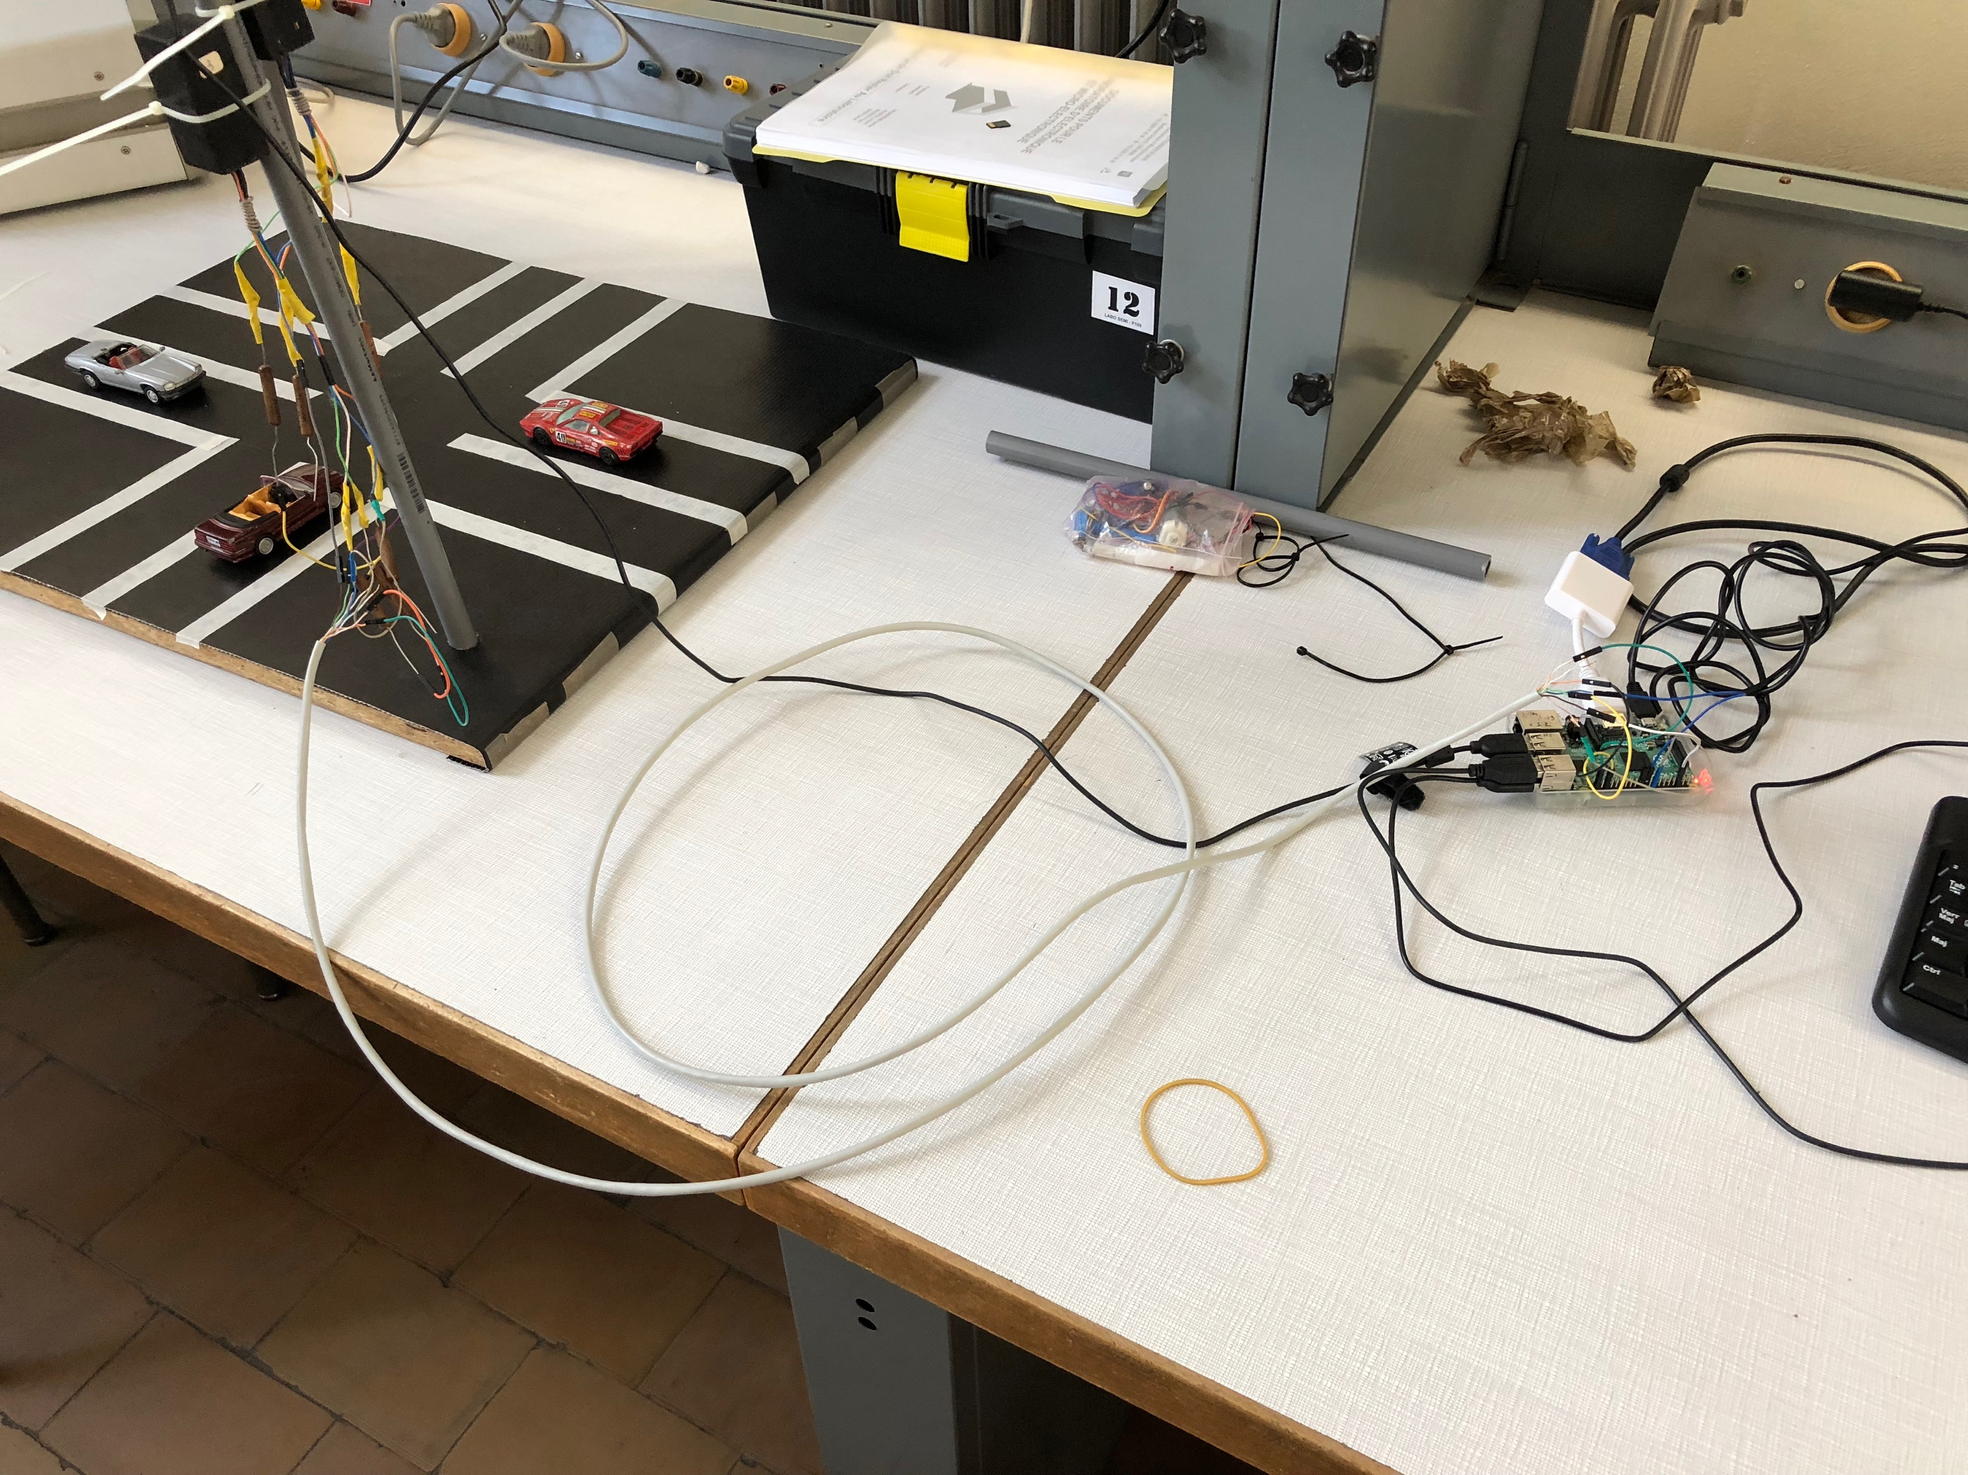
Global view of our project

Slide 4
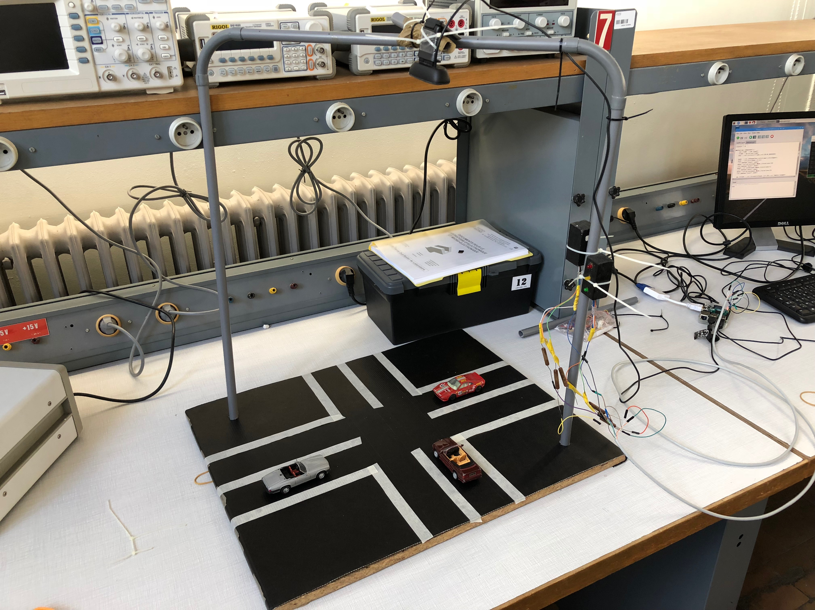
Global view of our project
Webcam
Traffic Lights

Slide 5
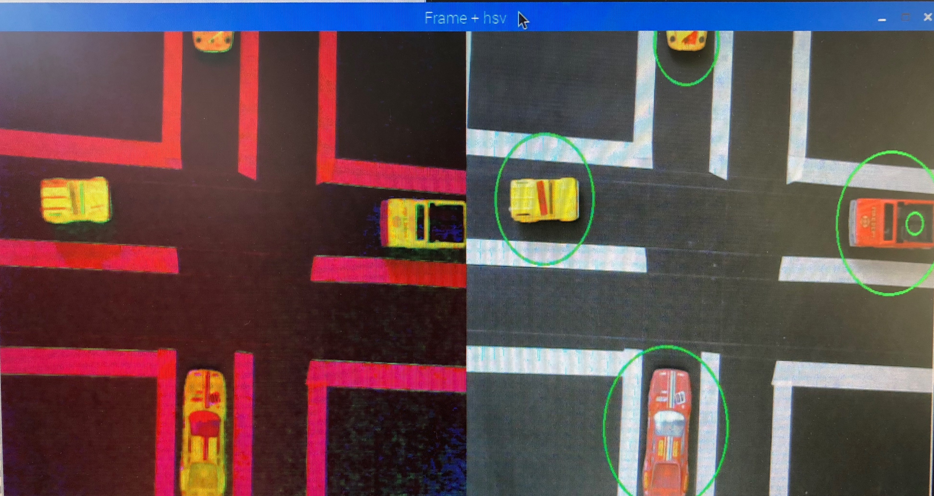
Detection of cars

Slide 6
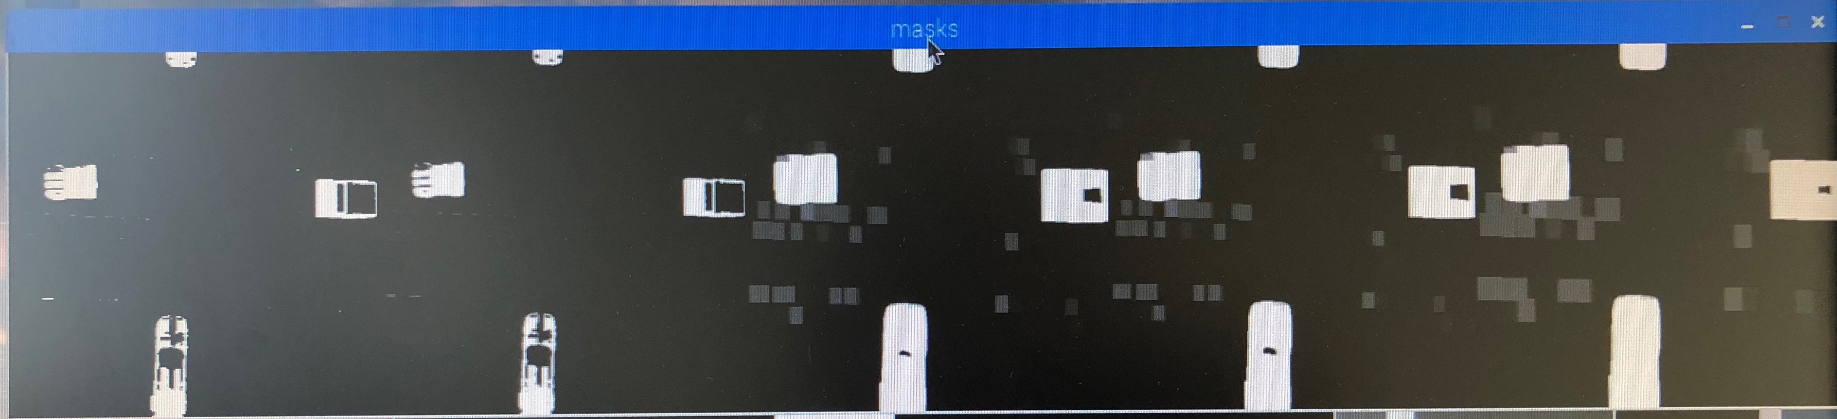
Detection of cars
Black/white
Blur
Dilate
Erode
Dilate

Slide 7
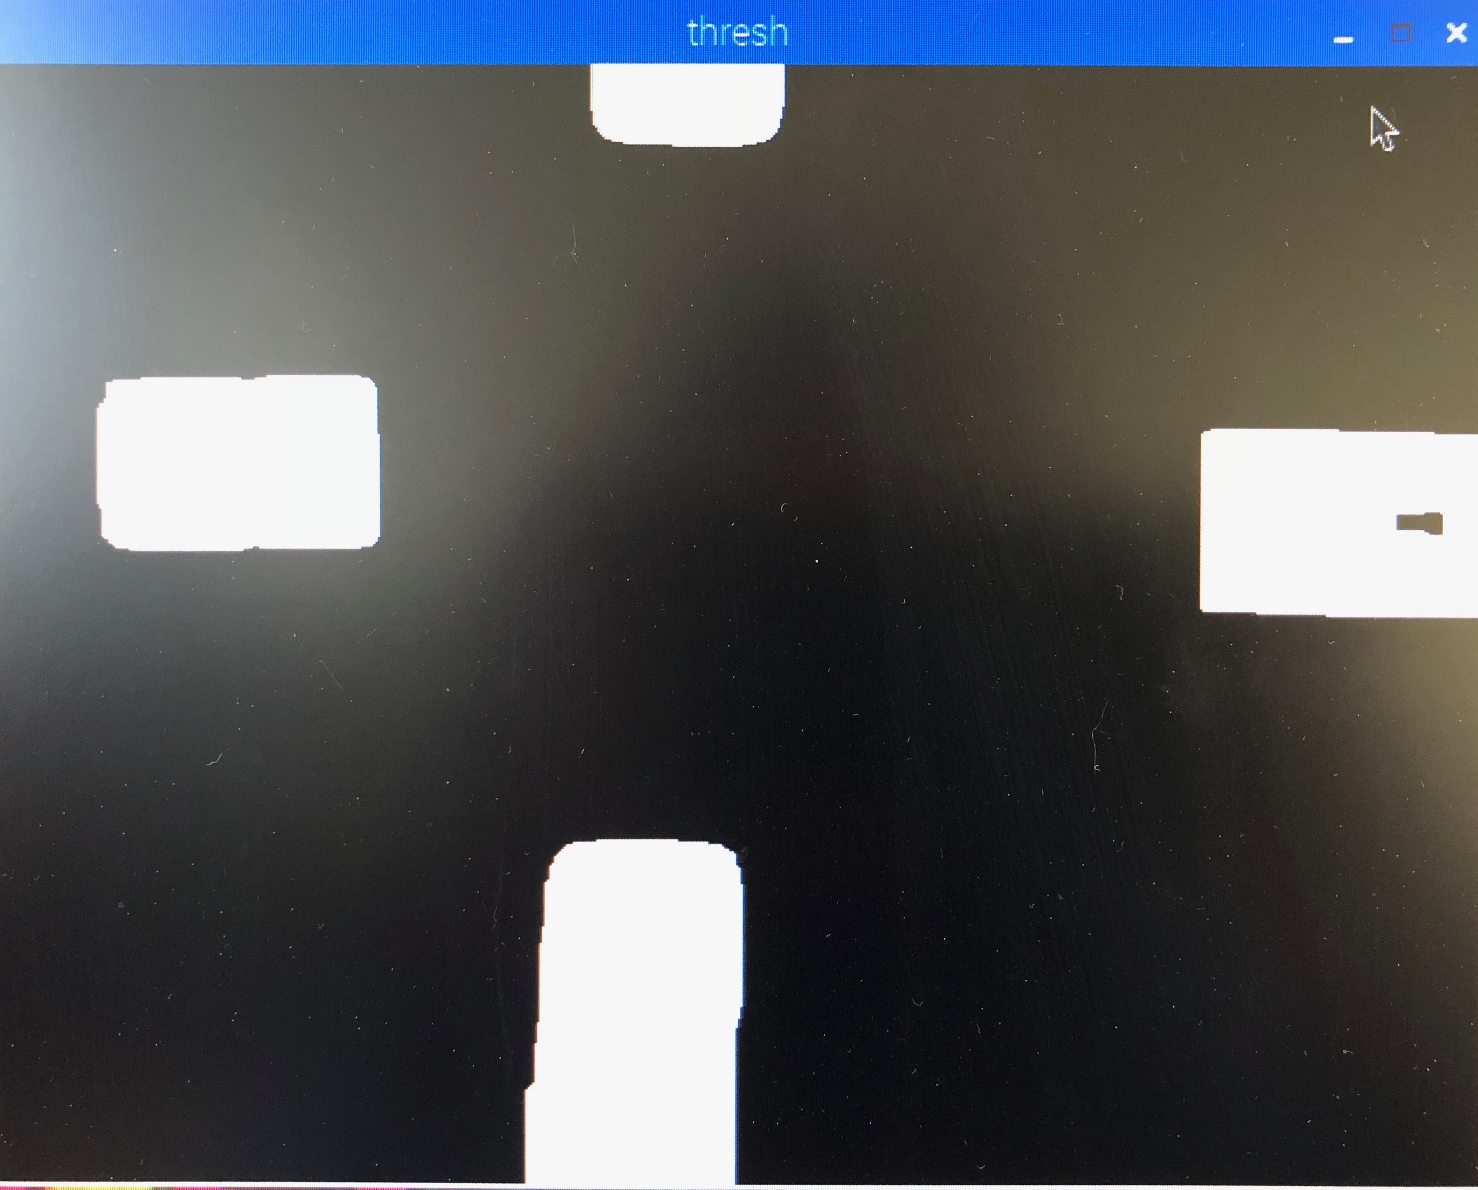
Detection of cars
Image from where contours are defined

Slide 8
Code
cam = PiCamera()
cam.resolution=(480,480)
cam.framerate=30
raw=PiRGBArray(cam, size=(480,480))
In original tutorial, PiCamera was used.
We decided to use a standard USB webcam.
Modifications of the code
cam=cv2.VideoCapture(0)
cam.set(4,480) #Width=480
cam.set(5,480) #Height=480
cam.set(6,30) #FrameRate = 30

Slide 9
Code
Some modifications made by us to improve the code :
Increase dilatation to be adapted to all kind of cars
View of all different masks (blur, dilate, erode)
Puts all images in one window for more visibility

Slide 10
Links
Link to the original tutorial :
Smart Traffic Light
TRAFFIC PATTERN ANALYZER USING LIVE OBJECT DETECTION
http://www.instructables.com/id/Smart-Traffic-Light/
Link to our GitHub :
https://github.com/Twitwi96/Smart-traffic-light-2

Slide 11
Links
Link to the presentation video:
https://www.youtube.com/watch?v=Fwua8g3W6qo&feature=youtu.be

